Slide 1


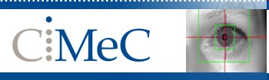
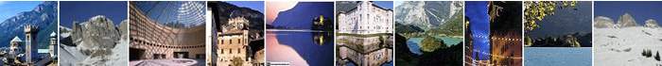
Brain Diffusion MRI Introduction
Louvain-la-Neuve - Neuroimaging Workshop 2019
Jorge Jovicich
Center for Mind/Brain Sciences (CIMeC),
University of Trento, Rovereto, Italy
CIMeC: https://www.cimec.unitn.it/
MRI Lab: http://r.unitn.it/en/cimec/mri
E-mail: jorge.jovicich@unitn.it

Slide 2
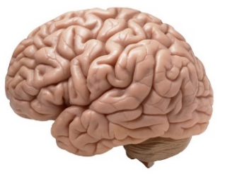
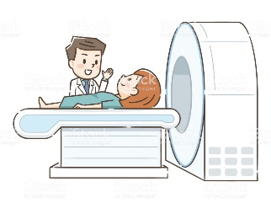
Concept map for lectures
Lecture 1
MR Image & Contrast
NMR Signal origin
MR Safety
Spatial encoding
Magnetic gradients
Pulse sequences
Powerful magnet
Radio frequency
Magnetic field gradients
Powerful magnet
Radio frequency
Magnetic field gradients
Lecture 2
Lecture 4
Structural MRI
Lecture 3
Functional MRI
Diffusion MRI
Contrast, important parameters
Sequences & artifacts
Analyses & applications
Contrast, important parameters
Sequences & artifacts
Pre-processing
Contrast, important parameters
Sequences & artifacts
Analyses & applications
Jorge Jovicich
CIMeC, University of Trento, Italy

Slide 3
Lecture 3 outline
Brain diffusion:
Why do we care?
How do we measure it?
How do we pre-process data?
Extracting information: models & challenges
Jorge Jovicich
CIMeC, University of Trento, Italy

Slide 4
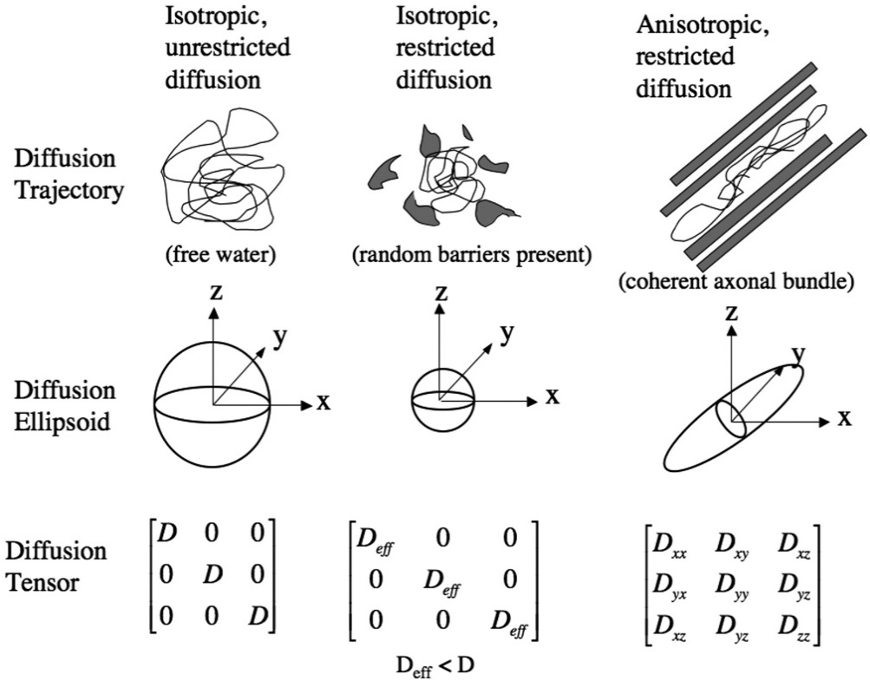

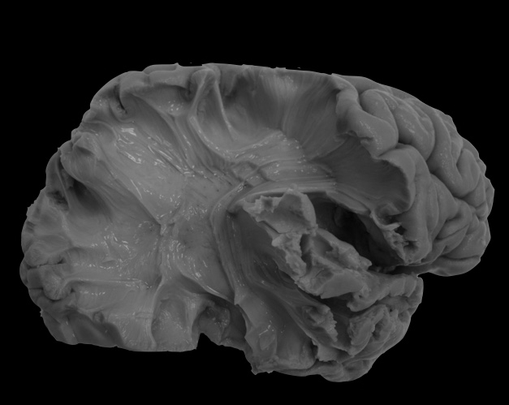
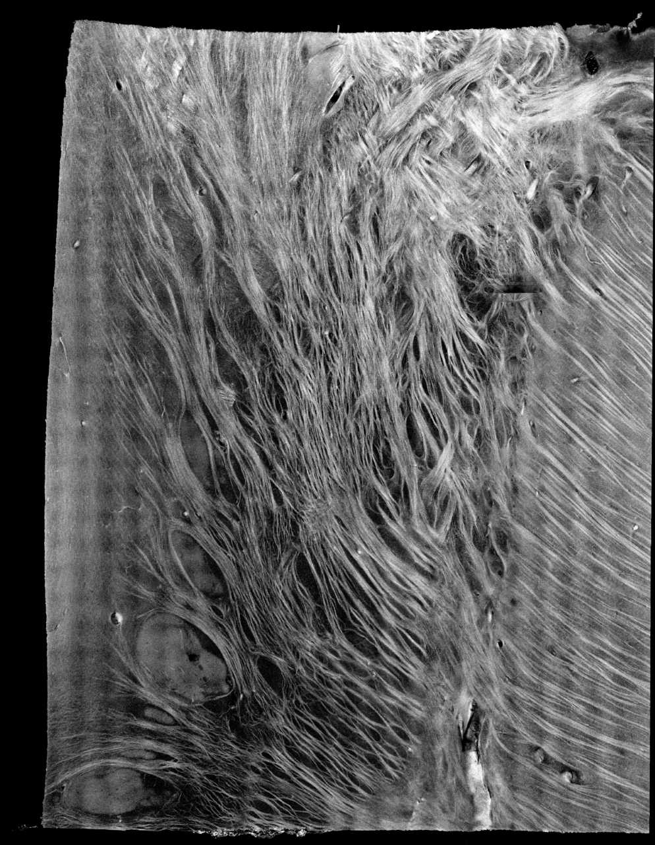
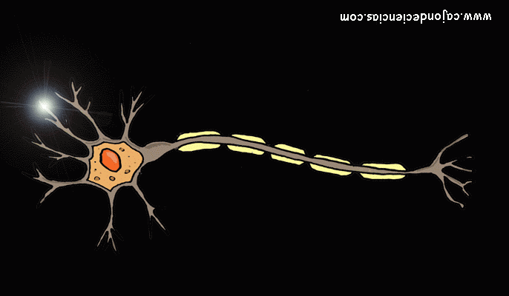
Diffusion MRI: Motivation
Brain anatomy characterization (in-vivo, non-invasive)
Brain tissue microstructure (axon diameter, density, myelination, etc.)
White matter fibers (orientations, connections, etc.)
Diffusion of water molecules in tissue
Reflects the local microstructural environment
Physical restrictions will affect diffusion magnitude and directionality
Diffusion MRI
Contrast sensitive magnitude and direction of water diffusion
Models relate the NMR signal with microstructure properties
1.5cm x 1.8cm,
8.5um x 8.5um
Courtesy of Hui Wang
Fibre diameters in human brains ranged from 0.16 to 9 μm
Liewald et al. 2014
Courtesy of Viviana Siless & Chiara Maffei
Jorge Jovicich
CIMeC, University of Trento, Italy

Slide 5
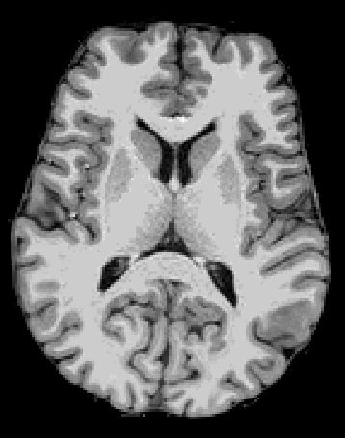
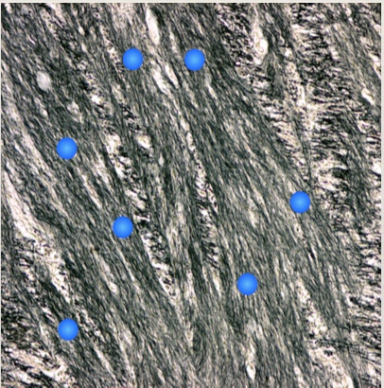
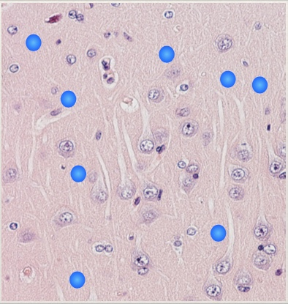
Water diffusion in the brain
Why bother about molecular diffusion in brain?
Water molecules diffuse differently inside biological tissues
We can differentiate brain tissues based on different diffusion profiles within them
White matter: anisotropic
Gray matter: isotropic
Courtesy of Viviana Siless & Chiara Maffei
Jorge Jovicich
CIMeC, University of Trento, Italy

Slide 6
Lecture 3 outline
Brain diffusion:
Why do we care?
How do we measure it?
How do we pre-process data?
Extracting information: models & challenges
Jorge Jovicich
CIMeC, University of Trento, Italy

Slide 7
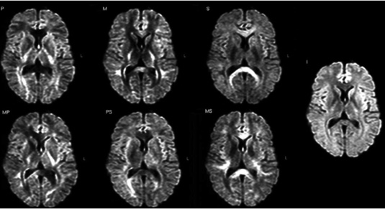
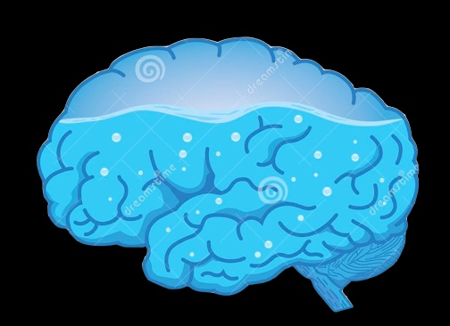

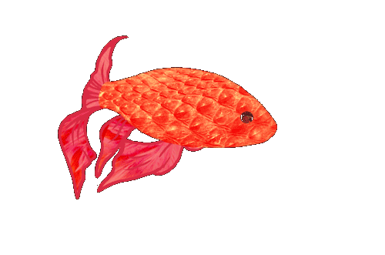
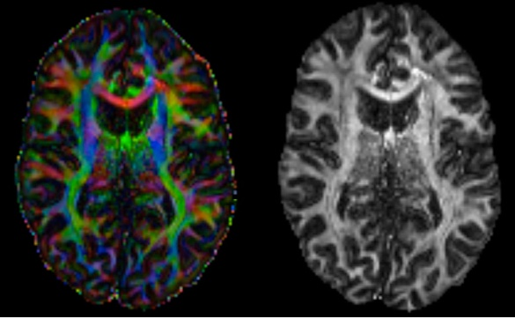
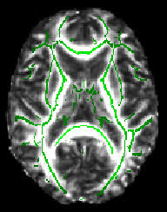
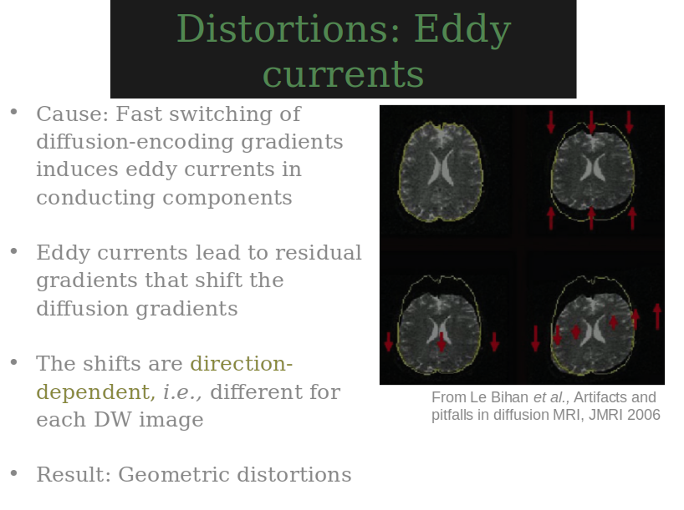
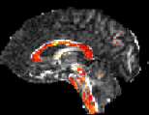
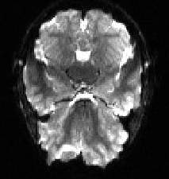
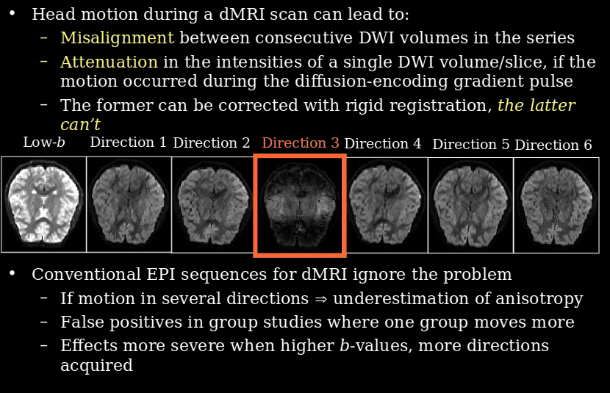
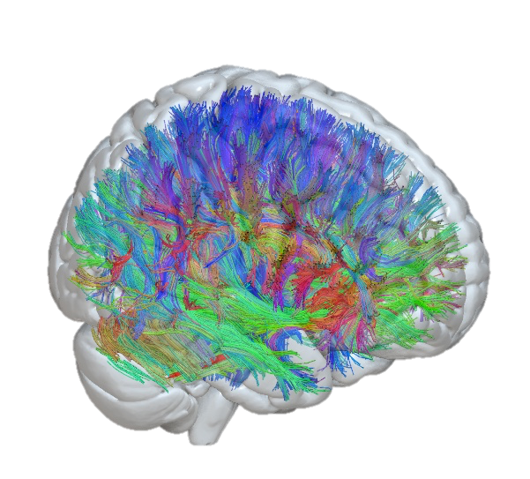
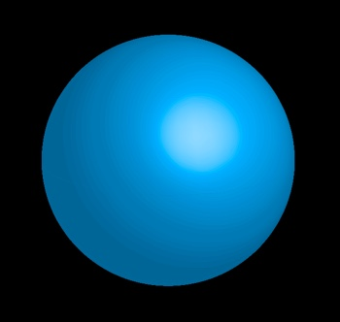
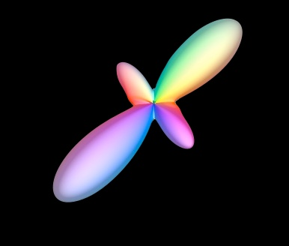
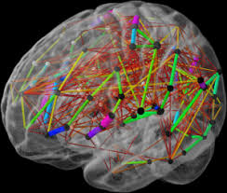
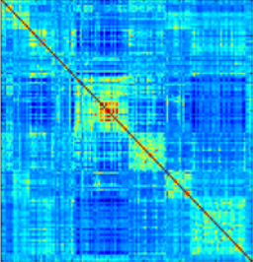
Diffusion MRI overview
90°
180°
?
microstructure
So
what?
connectivity
Modified from Viviana Siless & Chiara Maffei
Jorge Jovicich
CIMeC, University of Trento, Italy

Slide 8
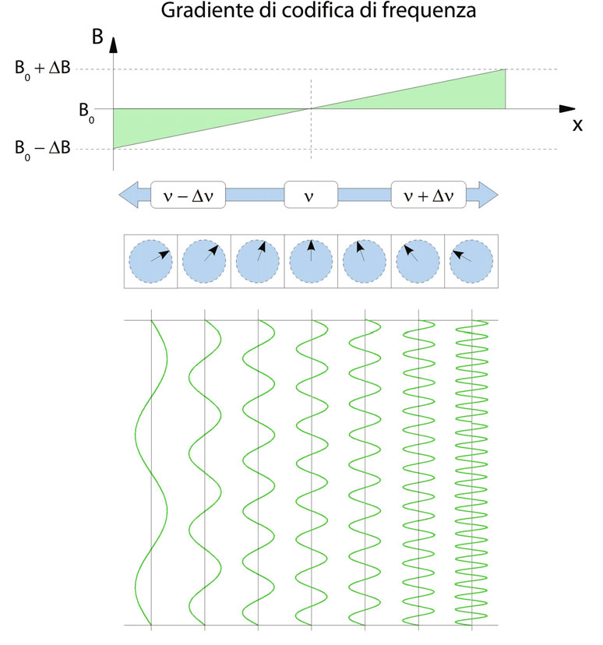
Diffusion contrast: based on gradients
REMINDER
Gradient along x-axis
Two spatial-encoding possibilities for the magnetization:
Phase changes along x-axis
Frequency changes along x-axix
Jorge Jovicich
CIMeC, University of Trento, Italy

Slide 9
Diffusion MRI: how do we measure it?
Pulse Gradient Spin Echo sequence (PGSE)
90°
180°
echo
G
gy
gy
y
δ
Δ
x
Gy Gradient
Courtesy of Viviana Siless & Chiara Maffei
Jorge Jovicich
CIMeC, University of Trento, Italy

Slide 10
Diffusion MRI: how do we measure it?
Pulse Gradient Spin Echo sequence (PGSE)
90°
180°
echo
G
gy
gy
y
δ
Δ
x
Diffusion in the x direction
→ No displacement along y-axis
→ No dephasing induced by y-gradient
→ No MR signal attenuation cause by diffusion y-gradient
Courtesy of Viviana Siless & Chiara Maffei
Jorge Jovicich
CIMeC, University of Trento, Italy

Slide 11
Diffusion MRI: how do we measure it?
Pulse Gradient Spin Echo sequence (PGSE)
90°
180°
echo
G
gx
gx
δ
Δ
y
x
Courtesy of Viviana Siless & Chiara Maffei
Jorge Jovicich
CIMeC, University of Trento, Italy

Slide 12
Diffusion MRI: how do we measure it?
Pulse Gradient Spin Echo sequence (PGSE)
90°
180°
echo
G
gx
gx
δ
Δ
Diffusion in the x direction
→ Displacement captured by the diffusion x-gradient
→ Dephasing of magnetization
→ Signal attenuation caused by diffusion gradients
y
x
Courtesy of Viviana Siless & Chiara Maffei
Jorge Jovicich
CIMeC, University of Trento, Italy

Slide 13
Diffusion MRI: how do we measure it?
Many possible configurations can appear in each voxel: In one mm cubic voxel there are millions of axons of ~um resolution.
Because of the orientation dependency in encoding diffusion, multiple diffusion directions (b-vector) are needed to cover the full 3D profile.
B₀ : baseline image
Multiple
gradient
encoding
directions
Sensitivity to diffusion in multiple directions
g1 g2 g3 g4 g5 g6
Diffusion weighted images (DWI)
Courtesy of Viviana Siless & Chiara Maffei
Jorge Jovicich
CIMeC, University of Trento, Italy
Notes:
Fully isotropical distributed directions are optimal. More directions are better than more averages for scan time. Trade off between bval and dw directions. The range of bval and bvecs sampled is called the q space

Slide 14
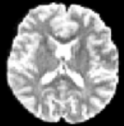
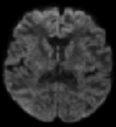
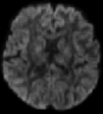
Diffusion MRI: how do we measure it?
Diffusion encoding:
Only along the specific direction applied
Image intensity is attenuated depending on water diffusion for the specific direction.
We compare each image direction to a baseline image (no direction, B0).
Baseline: B0
Low
dMRI
signal
g1
High
dMRI
signal
g2
Courtesy of Viviana Siless & Chiara Maffei
Jorge Jovicich
CIMeC, University of Trento, Italy
Notes:
No diffusion, the spins experience the same gradient encoding, they rewind, there is no dephase.

Slide 15
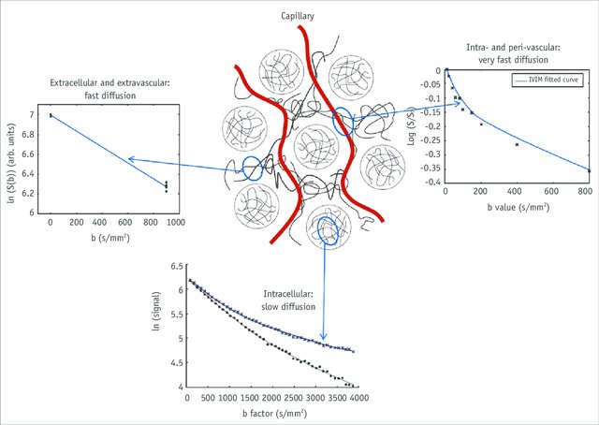
Diffusion MRI: what is the b-value?
MRI signal:
b-value (diffusion weight): Measure of diffusion sensitivity
Large b → strong diffusion sensitivity
The b-value depends on the sequence and acquisition parameters:
S_{(b)} = S₀ e^{-bD}
b = ɣ2 G² δ² (Δ - δ/3)
Pulse Gradient Spin Echo sequence (PGSE)
90°
180°
G
δ
Δ
Ɣ → gyromagnetic ratio
G → diffusion gradient strength
δ → duration of the diffusion-encoding pulse
Δ → the interval between diffusion pulses
Kim & Kim 2016
Jorge Jovicich
CIMeC, University of Trento, Italy

Slide 16
Diffusion MRI: why is the b-value important?
b-value increase ⇒ increased contrast between areas of higher and lower diffusivity
Higher diffusion sensitivity
Longer diffusion time
Increasing the length of the diffusion-encoding gradient pulses
→ Increased echo time (TE) → Decreased signal-to-noise-ratio (SNR)!
To scan with high b-value you need STRONG and FAST magnetic gradients ($$)
TE
G
G
δ
Δ
δ
Δ
Clinical MRI scanners → Gmax = 40 mT/m
Prisma scanner → Gmax = 80 mT/m (MGH)
HCP scanners → Gmax = 300 mT/m (MGH)
Some animal scanners → Gmax = 1000 mT/m
Gmax | Desired b | Needed δ | Resulting TE
40 mT/m | 1000 s/mm2 | 24 ms | 48 ms
1000 mT/m | 1000 s/mm2 | 3 ms | 6 ms
Modified from Viviana Siless & Chiara Maffei
Jorge Jovicich
CIMeC, University of Trento, Italy
Notes:
Add prisma

Slide 17
Diffusion MRI: why is the b-value important?
b-value increase ⇒ increased contrast between areas of higher and lower diffusivity
Higher diffusion sensitivity
Longer diffusion time
Increasing the length of the diffusion-encoding gradient pulses
→ Increased echo time (TE) → Decreased signal-to-noise-ratio (SNR)!
To scan with high b-value you need STRONG and FAST magnetic gradients ($$)
TE
G
G
δ
Δ
δ
Δ
Jorge Jovicich
CIMeC, University of Trento, Italy
Notes:
Add prisma

Slide 18
Diffusion MRI: b-value and gradient directions
In a voxel
many possible orientations for molecular diffusion
many different levels of diffusion
Ideally you want to acquire diffusion MRI data with
Different b-values (sensitivity to different ranges of diffusion)
Multiple gradient-encoding directions for each b-value (sensitivity in 3D space)
Derek Jones, 2010
B₀ baseline image
b1
b2
g1b1 g2b1 g3b1 g4b2 g5b2 g6b2
Modified from Viviana Siless & Chiara Maffei
Jorge Jovicich
CIMeC, University of Trento, Italy
Notes:
Fully isotropical distributed directions are optimal. More directions are better than more averages for scan time. Trade off between bval and dw directions. The range of bval and bvecs sampled is called the q space

Slide 19
Diffusion MRI data structure
Multiple 3D brain volumes, each one with fast-MRI (spin-echo Echo Planar Imaging)
Several of them are b0 (used for diffusion estimation and for head motion correction)
Several diffusion weighted images:
Single-shell: means there is one b-value for diffusion encoding,
multiple gradient encoding directions
Multi-shell: mean there are many different shells
Your pulse sequence defines the order in which b-values and directions are acquired
Diffusion MRI
acquisition
Schemes
(single/multishell)
b0 at start
b0
b0
b0
b0
DWI
...
DWI
b0 interleaved
b0
DWI
...
DWI
b0
DWI
...
DWI
...
b0
(some scanners average b0s)
Jorge Jovicich
CIMeC, University of Trento, Italy

Slide 20
Lecture 3 outline
Brain diffusion:
Why do we care?
How do we measure it?
How do we pre-process data?
Extracting information: models & challenges
Jorge Jovicich
CIMeC, University of Trento, Italy

Slide 21

Diffusion MRI pre-processing
Pre-processing: analyses steps to minimize noise, artifacts to get the «cleanest» data for models
Acquisition
dMRI nii
bval.txt
bvec.txt
Gibbs ringing
correction
dMRI
dicom
Signal Denoise
Geometric
Distortion
correction
Sample preparation
Eddy & motion correction
Quality
check
Bias field correction
b-vector
reorientation
Signal
model
etc.
Various pre-processing tools available:
https://tortoise.nibib.nih.gov
https://fsl.fmrib.ox.ac.uk/fsl/fslwiki/FDT
https://www.mrtrix.org
...
This is a generic example
Jury out for optimal details
Jorge Jovicich
CIMeC, University of Trento, Italy

Slide 22

Diffusion MRI pre-processing
dMRI
dicom
dMRI nii
bval.txt
bvec.txt
Signal Denoise
Gibbs ringing
correction
Geometric
Distortion
correction
Sample preparation
Eddy & motion correction
Signal
model
etc.
Quality
check
Bias field correction
b-vector
reorientation
Various pre-processing tools available:
https://tortoise.nibib.nih.gov
https://fsl.fmrib.ox.ac.uk/fsl/fslwiki/FDT
https://www.mrtrix.org
...
This is a generic example
Jury out for optimal details
Jorge Jovicich
CIMeC, University of Trento, Italy

Slide 23
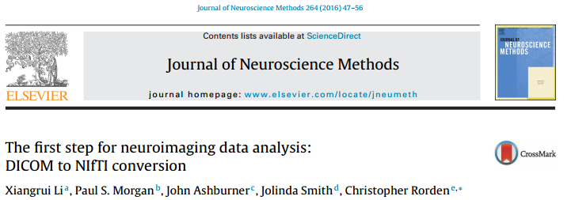
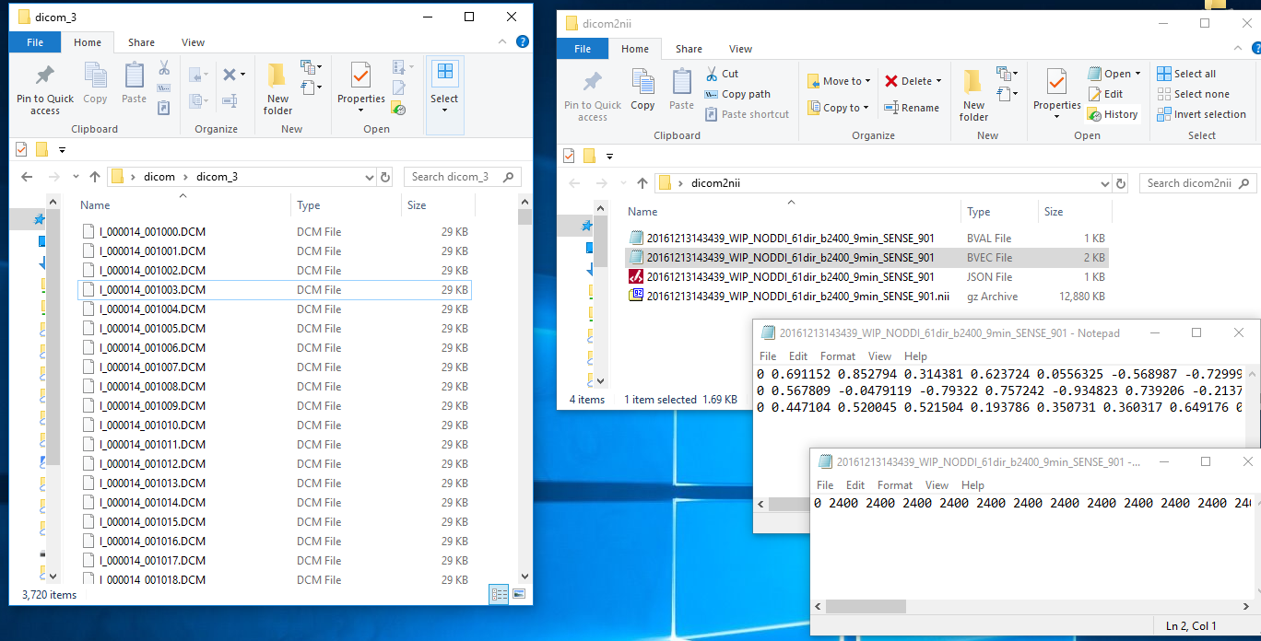
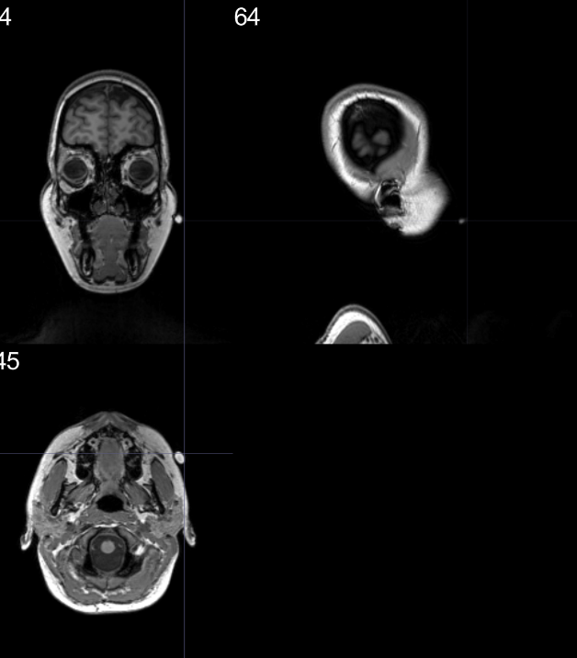

Diffusion MRI: reformatting
dicom2nii
Marker helps
Check right/left
Jorge Jovicich
CIMeC, University of Trento, Italy

Slide 24
Diffusion MRI pre-processing
dMRI
dicom
dMRI nii
bval.txt
bvec.txt
Signal Denoise
Gibbs ringing
correction
Geometric
Distortion
correction
Sample preparation
Eddy & motion correction
Signal
model
etc.
Quality
check
Bias field correction
b-vector
reorientation
Various pre-processing tools available:
https://tortoise.nibib.nih.gov
https://fsl.fmrib.ox.ac.uk/fsl/fslwiki/FDT
https://www.mrtrix.org
...
This is a generic example
Jury out for optimal details
Jorge Jovicich
CIMeC, University of Trento, Italy

Slide 25
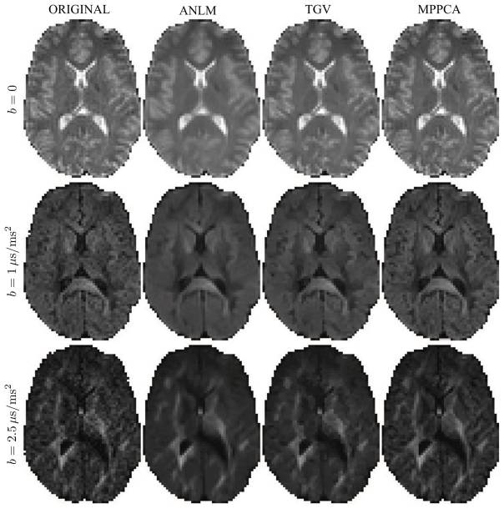
Diffusion MRI: Signal denoising
Thermal noise sources
Detection system: random electron motion in electronic
Sample: random spin fluctuations
Noise in diffusion MR signal
Will propagate through analysis & modelling
Will affect accuracy and reproducibility
Need to optimize SNR with acquisition parameter choices
Post processing noise reduction
Smoothing
Blurs image, spatial resolution loss
Total generalized variation regularization
Preserve edges
Regularization parameter dependent
Principal component analysis
Uses data redundancy
Preserves accuracy and spatial resolution
Identifyes + eliminates noise-only components
RAW
ANLM
TGV
MPPCA
Manjon et al. Med. Image Anal.c 2008
Rudin et al. D: Nonlinear Phenomena, 1992
Hotelling, J. Educ. Psychol., 1933
Veraart et al. NeuroImage, 2016
Jorge Jovicich
CIMeC, University of Trento, Italy

Slide 26
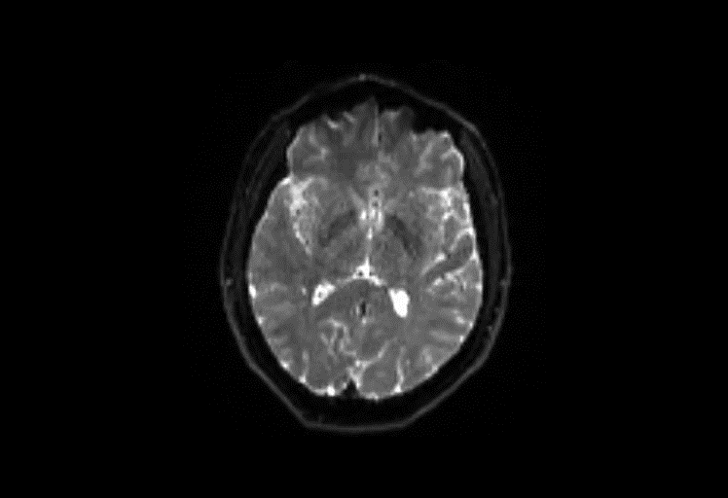

Diffusion MRI: Signal denoising
Raw data
MPPCA denoised data
3T Siemens Prisma example (1.8mm isotropic, TE=72ms, TR=5.2s)
number of b0: 5 (1 at the beginning, 4 at the end)
number of directions per each shell: 64
b-values (>0): 500, 1500, 3000 s/mm2 (17 min acquisition)
Jorge Jovicich
CIMeC, University of Trento, Italy

Slide 27
Diffusion MRI pre-processing
dMRI
dicom
dMRI nii
bval.txt
bvec.txt
Signal Denoise
Gibbs ringing
correction
Geometric
Distortion
correction
Sample preparation
Eddy & motion correction
Signal
model
etc.
Quality
check
Bias field correction
b-vector
reorientation
Various pre-processing tools available:
https://tortoise.nibib.nih.gov
https://fsl.fmrib.ox.ac.uk/fsl/fslwiki/FDT
https://www.mrtrix.org
...
This is a generic example
Jury out for optimal details
Jorge Jovicich
CIMeC, University of Trento, Italy

Slide 28
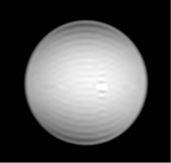
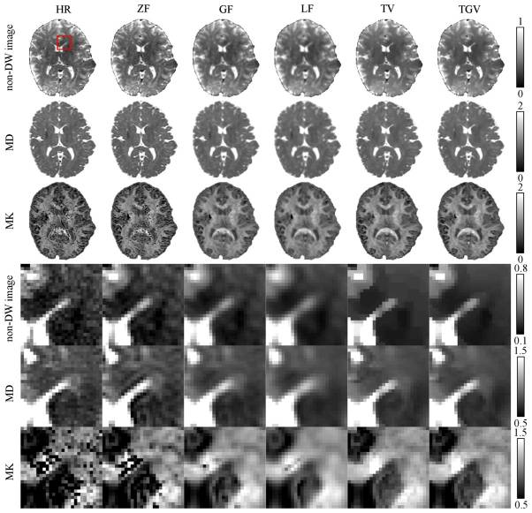
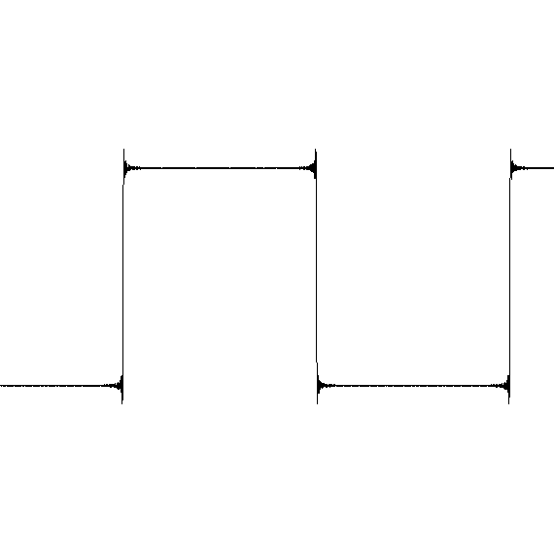
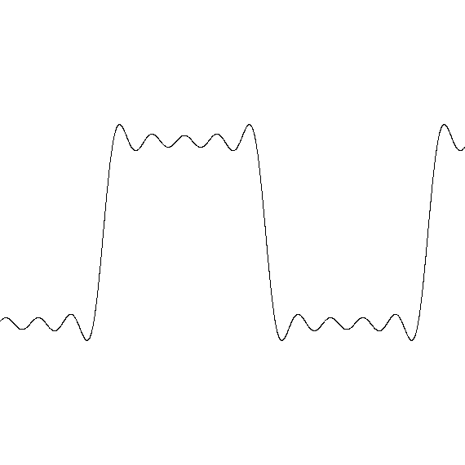
Diffusion MRI: Gibbs ringing
What is Gibbs ringing?
Every signal can be decomposed by an infinite Fourier series
A truncated series gives an imperfect signal representation
At signal «edges» this effect is seen as artificial signal ringing fluctuations
Step function representation
CSF
Corpus
Callosum
125 harmonics
CSF
Corpus
Callosum
5 harmonics
https://en.wikipedia.org/wiki/Gibbs_phenomenon
Veraart et al. MRM, 2016
Jorge Jovicich
CIMeC, University of Trento, Italy

Slide 29
Diffusion MRI: Gibbs ringing correction
Correction: reinterpolate the image based on local, subvoxel-shifts to sample the ringing pattern at the zero-crossings of the oscillating sinc-function (Kellner et al., MRM 2016)
[Full k-space acquisition assumption]
Jorge Jovicich
CIMeC, University of Trento, Italy

Slide 30
Diffusion MRI: Gibbs ringing correction
Effects on FA
Uncorrected
Corrected
MRITrix course
Jorge Jovicich
CIMeC, University of Trento, Italy

Slide 31
Diffusion MRI pre-processing
Field map
dMRI
dicom
dMRI nii
bval.txt
bvec.txt
Signal Denoise
Gibbs ringing
correction
Geometric
Distortion
correction
3D T2
SE-EPI
AP/PA
Sample preparation
Eddy & motion correction
Signal
model
etc.
Quality
check
Bias field correction
b-vector
reorientation
Various pre-processing tools available:
https://tortoise.nibib.nih.gov
https://fsl.fmrib.ox.ac.uk/fsl/fslwiki/FDT
https://www.mrtrix.org
...
This is a generic example
Jury out for optimal details
Jorge Jovicich
CIMeC, University of Trento, Italy

Slide 32
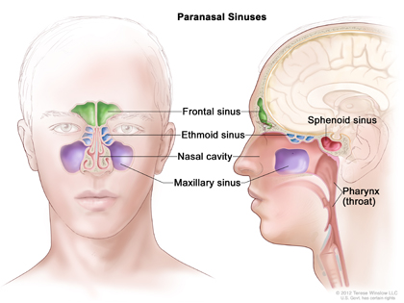
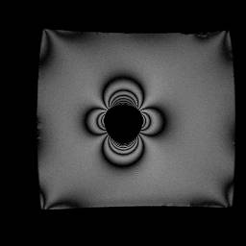
Diffusion MRI: susceptibility distortions
Image reconstruction assumes uniform B₀ in the sample
True field is different:
Water
B_{o}
Air
B₀ field map
(coronal image) 1.5T
Phantom images courtesy of Larry Wald
Jorge Jovicich
CIMeC, University of Trento, Italy

Slide 33
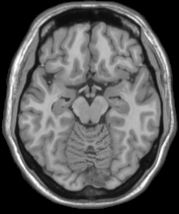
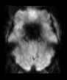
Diffusion MRI: susceptibility distortions
Image reconstruction assumes uniform B₀ in the sample
True field is different:
As a result, fast diffusion images (Echo Planar Images, EPI) show:
areas with signal loss (where T2*<<TE): nothing to do!
Jorge Jovicich
CIMeC, University of Trento, Italy

Slide 34
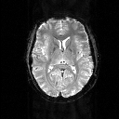
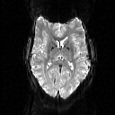
Diffusion MRI: susceptibility distortions
Image reconstruction assumes uniform B₀ in the sample
True field is different:
As a result, fast diffusion images (Echo Planar Images, EPI) show:
areas with signal loss (where T2*<<TE): nothing to do!
areas with geometric distortions: something to do!
Voxel shifts relative to true voxel location:
Δx, Δy : voxel shifts in x, y directions in mm
γ: proton gyromagnetic ratio
FOVx, FOVy : field of view in x, y direction in mm
Δtx, Δty : sampling interval in x, y direction (∝ 1/sampling rate)
Jorge Jovicich
CIMeC, University of Trento, Italy

Slide 35
Diffusion MRI: susceptibility distortions
Diffusion data overlaid on T1 anatomical
Data are not aligned due to uncorrected distortions
Tournier et al., MRM 2011
Jorge Jovicich
CIMeC, University of Trento, Italy

Slide 36
Diffusion MRI pre-processing
Field map
dMRI
dicom
dMRI nii
bval.txt
bvec.txt
Signal Denoise
Gibbs ringing
correction
Geometric
Distortion
correction
3D T2
SE-EPI
AP/PA
Sample preparation
Eddy & motion correction
Signal
model
etc.
Quality
check
Bias field correction
b-vector
reorientation
Various pre-processing tools available:
https://tortoise.nibib.nih.gov
https://fsl.fmrib.ox.ac.uk/fsl/fslwiki/FDT
https://www.mrtrix.org
...
This is a generic example
Jury out for optimal details
Jorge Jovicich
CIMeC, University of Trento, Italy

Slide 37
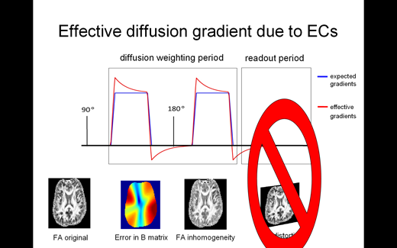
Diffusion MRI: Eddy and motion correction
Diffusion MRI
acquisition
Schemes
(single/multishell)
b0 at start
b0
b0
b0
b0
DWI
...
DWI
b0 interleaved
b0
DWI
...
DWI
b0
DWI
...
DWI
...
b0
(some scanners average b0s)
You wish!
In reality
spins experience
another induced
gradient
Veraart, ISMRM 2019
Assumed gradient waveform
Effective gradient waveform
Jorge Jovicich
CIMeC, University of Trento, Italy

Slide 38
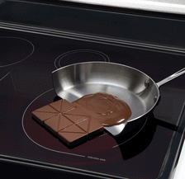
Sometimes Eddy currents are welcome
Induction kitchen principle
http://mriquestions.com/eddy-current-problems.html
Jorge Jovicich
CIMeC, University of Trento, Italy

Slide 39
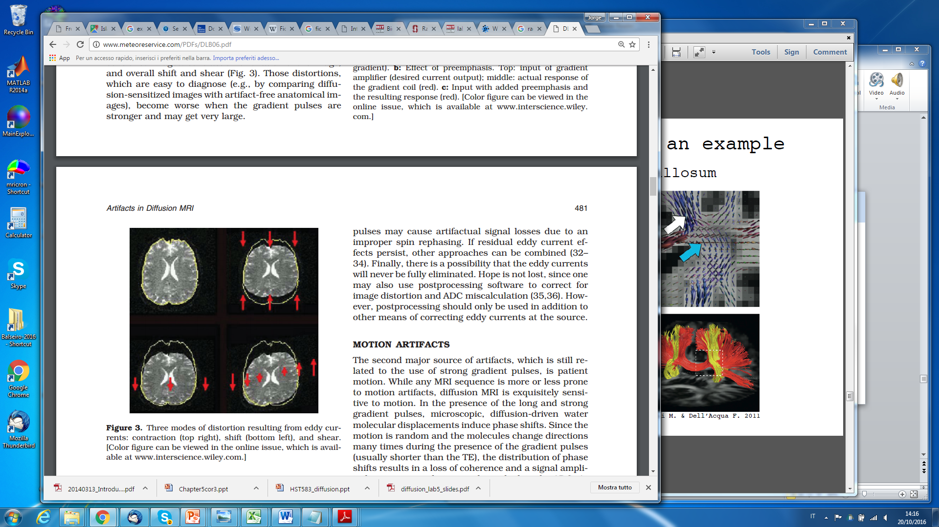
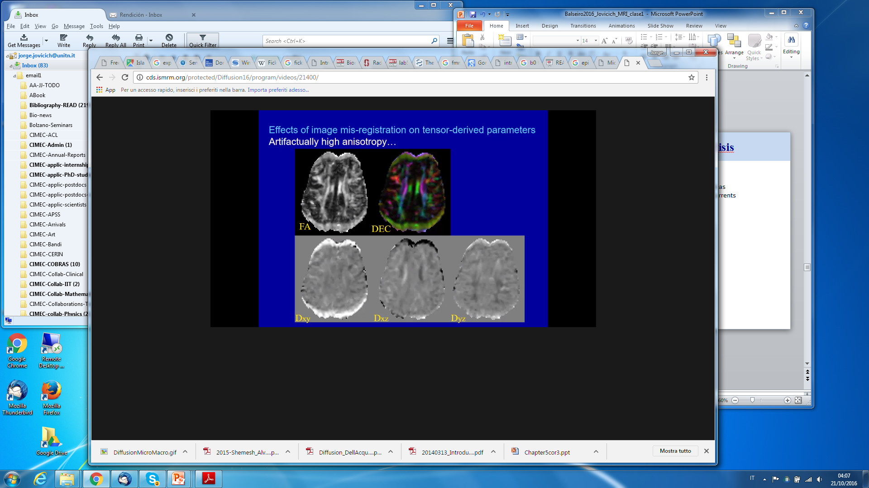
Diffusion MRI: Eddy current distortions
Electrical currents in induced inside the MRI cryostat
They generate a magnetic field gradient that adds to the intended one
The net gradient is incorrect leading to image geometric distortions
b0
DWI
DWI
DWI
Le Bihan et al., Artifacts and pitfalls in diffusion MRI, JMRI 2006
Pierpaoli, ISMRM Diffusion, 2016
Eddy currents: strongest effects in phase-encoding direction
Jorge Jovicich
CIMeC, University of Trento, Italy

Slide 40
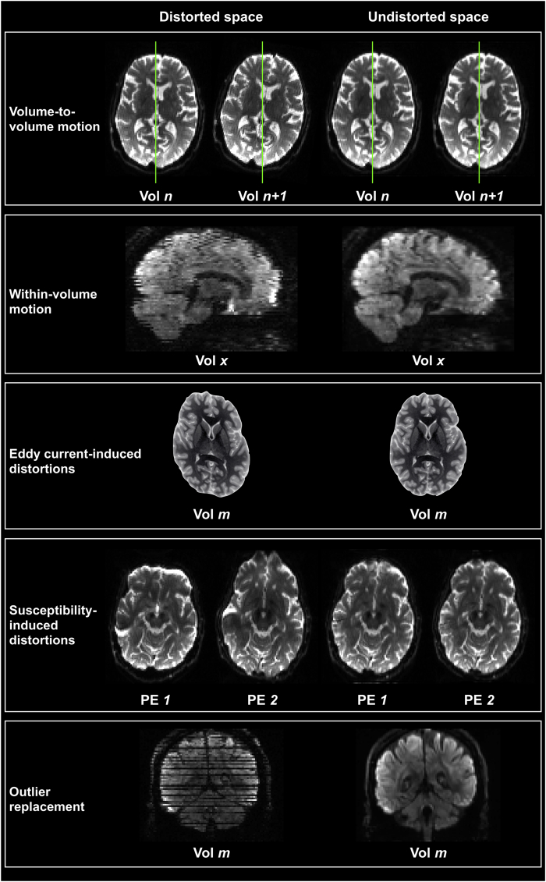
Diffusion MRI: head motion
Minimizing head motion:
Subject preparation
Subject fixation
Acquisition as short as needed
Prospective correction
Retrospective correction
Spatial model Eddy fields
Optimized registrations
Bastiani et al., Neuroimage 2019
Jorge Jovicich
CIMeC, University of Trento, Italy

Slide 41
Diffusion MRI: head motion & Eddy currents
Bastiani et al., Neuroimage 2019
Jorge Jovicich
CIMeC, University of Trento, Italy

Slide 42

Diffusion MRI: head motion & Eddy currents
Before any correction | After correction for: eddy currents, gross subject movement, static susceptibility map | After correction for: eddy currents, gross subject movement dynamic susceptibility map
https://fsl.fmrib.ox.ac.uk/fsl/fslwiki/eddy
Andersson et al., Neuroimage 2018
Jorge Jovicich
CIMeC, University of Trento, Italy

Slide 43

Diffusion MRI: head motion & Eddy currents
Raw data
Eddy current correction
3T Siemens Prisma example:
number of b0: 5 (1 at the beginning, 4 at the end)
number of directions per each shell: 64
b-values (>0): 500, 1500, 3000 s/mm2.
Jorge Jovicich
CIMeC, University of Trento, Italy

Slide 44

Diffusion MRI: head motion & Eddy currents
Uncorrected
corrected
Pierpaoli, ISMRM Diffusion, 2016
Tournier et al., MRM 2011
Jorge Jovicich
CIMeC, University of Trento, Italy

Slide 45
Diffusion MRI: pre-processing
Field map
dMRI
dicom
dMRI nii
bval.txt
bvec.txt
Signal Denoise
Gibbs ringing
correction
Geometric
Distortion
correction
3D T2
SE-EPI
AP/PA
Sample preparation
Eddy & motion correction
Signal
model
etc.
Quality
check
Bias field correction
b-vector
reorientation
Various pre-processing tools available:
https://tortoise.nibib.nih.gov
https://fsl.fmrib.ox.ac.uk/fsl/fslwiki/FDT
https://www.mrtrix.org
...
This is a generic example
Jury out for optimal details
Jorge Jovicich
CIMeC, University of Trento, Italy

Slide 46
Diffusion MRI: pre-processing
dMRI
dicom
dMRI nii
bval.txt
bvec.txt
Signal Denoise
Gibbs ringing
correction
Geometric
Distortion
correction
Sample preparation
Eddy & motion correction
Signal
model
etc.
Quality
check
Bias field correction
b-vector
reorientation
Various pre-processing tools available:
https://tortoise.nibib.nih.gov
https://fsl.fmrib.ox.ac.uk/fsl/fslwiki/FDT
https://www.mrtrix.org
...
This is a generic example
Jury out for optimal details
Jorge Jovicich
CIMeC, University of Trento, Italy

Slide 47
Diffusion MRI: Bias field correction
Imperfect B1 modulation
Intensity modulation
Evaluate with image intensity windowing
Correction strategies
Estimate B1 map on b0
Apply correction to all dMRI data
ANTs N4 (no priors) fits smooth bias field that maximizes frequency
Tustison et al., IEEE Trans Med Imag 2010
Jorge Jovicich
CIMeC, University of Trento, Italy

Slide 48
Diffusion MRI: pre-processing
dMRI
dicom
dMRI nii
bval.txt
bvec.txt
Signal Denoise
Gibbs ringing
correction
Geometric
Distortion
correction
Sample preparation
Eddy & motion correction
Signal
model
etc.
Quality
check
Bias field correction
b-vector
reorientation
Various pre-processing tools available:
https://tortoise.nibib.nih.gov
https://fsl.fmrib.ox.ac.uk/fsl/fslwiki/FDT
https://www.mrtrix.org
...
This is a generic example
Jury out for optimal details
Jorge Jovicich
CIMeC, University of Trento, Italy

Slide 49
Diffusion MRI: Quality check
Visual inspection
Informative but time consuming
Look at summary metrics
Standard deviation map across DWI (Eddy currents)
Standard deviatin across b0 (cardiac pulsation)
Diffusion tensor residual map
Tournier et al., MRM 2011
Bed vibrations
Insufficient fat suppression
RF spike/interference

Slide 50
Diffusion MRI: Quality check
Visual inspection
Informative but time consuming
Look at summary metrics
Standard deviation map across DWI (Eddy currents)
Standard deviatin across b0 (cardiac pulsation)
Diffusion tensor residual map
...
Automated quality tools
TORTOISE (https://www.nitrc.org/projects/tortoise)
DTIprep (https://www.nitrc.org/projects/dtiprep)
DTI Studio (http://dsi-studio.labsolver.org)
SQUAD – FSL (https://git.fmrib.ox.ac.uk/matteob/eddy_qc_release.git)
...
Tournier et al., MRM 2011
Bed vibrations
Insufficient fat suppression
Jorge Jovicich
CIMeC, University of Trento, Italy

Slide 51


Diffusion MRI: Quality check
SQUAD – FSL (https://git.fmrib.ox.ac.uk/matteob/eddy_qc_release.git)
Bastiani et al., Neuroimage 2019
Jorge Jovicich
CIMeC, University of Trento, Italy

Slide 52

Diffusion MRI: Quality check
SQUAD – FSL (https://git.fmrib.ox.ac.uk/matteob/eddy_qc_release.git)
Gaussian process model used to replace an motion outlier volume with a new one
Bastiani et al., Neuroimage 2019
Jorge Jovicich
CIMeC, University of Trento, Italy

Slide 53
Diffusion MRI: pre-processing
dMRI
dicom
dMRI nii
bval.txt
bvec.txt
Signal Denoise
Gibbs ringing
correction
Geometric
Distortion
correction
Sample preparation
Eddy & motion correction
Signal
model
etc.
Quality
check
Bias field correction
b-vector
reorientation
Various pre-processing tools available:
https://tortoise.nibib.nih.gov
https://fsl.fmrib.ox.ac.uk/fsl/fslwiki/FDT
https://www.mrtrix.org
...
This is a generic example
Jury out for optimal details
Jorge Jovicich
CIMeC, University of Trento, Italy

Slide 54



Diffusion MRI: Acquisition factors
Diffusion sensitivity (modelling)
High b-value, multiple b-values (↓SNR)
High # directions per b-value (↑acq time)
Maximize speed:
Single-shot EPI (multishot challenges)
Shortest volume TR (> 5. T₁ relevant tissue)
Simultaneous multislice (shortens TR, no SNR costs)
Multichannel coils (enables SMS)
Parallel imaging (accelerates with SNR costs, ↓distortions)
Fast and strong magnetic gradients ($, PNS)
Maximize SNR
Shortest TE possible (attention w. acceleration)
As much data as possible (↑acq time)
Voxel size compromise with resolution
Postprocessing denoising
Minimize distortions
Eddy currents distortions
B0 inhomogeneity distortions
Gradient non-linearity distortions
Minimize artifacts
Gradient directions check
Fat suppression
Motion correction
Partial volume: Isotropic voxels, whole-brain
Cardiac gating
Gibbs ringing
Diffusion sensitivity, speed, SNR
no distortions,
no artifacts
Impossible to optimize everything
General guidelines
Optimization details depend on goals
Jorge Jovicich
CIMeC, University of Trento, Italy

Slide 55
Lecture 3 outline
Brain diffusion:
Why do we care?
How do we measure it?
How do we pre-process data?
Extracting information: models & challenges
Jorge Jovicich
CIMeC, University of Trento, Italy

Slide 56

Diffusion tensor model
A simple way of describing the directional dependence of diffusion is by using a diffusion tensor (DT)
A DT is 3x3 symmetric, positive-definite matrix
λ1/ε1
Basser et al. 1994
λ3/ε3
DT has 3 positive eigenvalues: λ1 λ2 λ3 → define the form of DT
DT has 3 orthogonal eigenvectors: ε1 ε2 ε3 → define the orientation of DT
λ2/ε2
Isotropy
Axial anisotropy
Planar anisotropy
λ1 = λ2 = λ3
λ1 >> λ2 ~ λ3
λ1 = λ2 >> λ3
Jorge Jovicich
CIMeC, University of Trento, Italy
Notes:
How do we reperesent and visualize diffusion at each voxel in the brain?

Slide 57



Diffusion tensor: microstructure estimates
λ1
λ2
Fractional Anisotropy (FA)
Mean Diffusivity (MD)
λ3
λ1+ λ2 + λ3
3
Jorge Jovicich
CIMeC, University of Trento, Italy

Slide 58


Diffusion tensor: microstructure estimates
λ1
λ2
Axial diffusivity (AD)
Radial diffusivity (RD)
λ3
AD(x,y,z) = λ₁(x,y,z)
Largest eigenvalue
RD(x,y,z) = [λ₂(x,y,z) + λ₃(x,y,z)]/2
Average of two lower eigenvalues
Jorge Jovicich
CIMeC, University of Trento, Italy

Slide 59
Diffusion tensor: model limitations
Challenge interpreting diffusion tensor results
Different biological processes may give similar estimations
Lack of specificity in terms of microstructure interpretation
FA in group 1
FA reduction in group 2
Decrease in
axon coherence?
Decrease in
myelin?
Both?
DTI white matter changes are not specific to the candidate cellular and molecular mechanisms driving the changes
Jorge Jovicich
CIMeC, University of Trento, Italy

Slide 60

Diffusion tensor: microstructure estimates
Errors in areas with fiber crossing
DellAcqua Flavio, HBM 2015
Jorge Jovicich
CIMeC, University of Trento, Italy

Slide 61

Diffusion tensor: microstructure estimates
Areas with strong fiber crossing: wrong scalar estimations
Low fractional anisotropy (FA)
DellAcqua Flavio, HBM 2015
Jorge Jovicich
CIMeC, University of Trento, Italy

Slide 62



Beyond the diffusion tensor
Spherical Deconvolution (single and multishell):
Voxel signal response decomposed by stick responses with a fiber Orientation Densitity Function (fODF)
Diffusion Kurtosis Imaging (multishell):
Estimates the non-Gaussianity of the voxel
4th order tensor!
AxCaliber (multishell):
Measures axon diameter distribution
Steven et al. 2014
NODDI (multishell):
Estimates the orientation and dispersion of axons
FA OD Vic Viso
Assaf et al. 2008
OD: orientation dispersion
V_{IC}: volume fraction of intracellular compartment
V_{ISO}: volume fraction of isotropic CSF
Zhang et al. 2012
Jorge Jovicich
CIMeC, University of Trento, Italy

Slide 63
Diffusion MRI: Tractography
Jorge Jovicich
CIMeC, University of Trento, Italy

Slide 64
Concept map for lectures
Jorge Jovicich
CIMeC, University of Trento, Italy

Slide 65
Outline of tractography concepts
Tractography variables
Streamlines, seeds, step-size, interpolation
Starting and stopping criteria
Algorithm: deterministic vs. Probabilistic
Tractography quantification
Voxel-wise track counts (Track Density Imaging)
Structural connection strength
Both have issues:
Biases to longer tracks
Biases to simpler tracks
Errors from noise & modelling
Jorge Jovicich
CIMeC, University of Trento, Italy

Slide 66
Brain diffusion MRI challenges
Validation
Ex-vivo brain (hystology, dissection, axial tracings)
Phantom (digial, physical)
Quantification
What is connection strength? (#, volume of streamlines)
Integrated data from multiple modalities (T1, FA, myelin, etc)
Evaluation of quantitative maps along tracts
Promises: use morphology to estimate topology
Poupon et al., 2010
Jorge Jovicich
CIMeC, University of Trento, Italy

Slide 67
Literature recommendations include
.
Papers
Tournier. Diffusion MRI in the brain - Theory and concepts. Prog Nucl Magn Reson Spectrosc. 2019;112-113:1-16
Maier-Han et al., The challenge of mapping the human connectome based on diffusion tractography. Nat Comm. 2017;8(1):1349.
Jeurissen et al., Diffusion MRI fiber tractography of the brain. NMR Biomed. 2019;32(4):e3785
Le Bihan D, Iima M. Diffusion MRI: What Water Tells Us about Biological Tissues. PLoS Biol. 2015 Jul 23;13(7):e1002203
Microstructural imaging
...
http://www.ncbi.nlm.nih.gov/pmc/?term=diffusion+mri+review
Web materials:
OHBM Educacional Series: https://www.pathlms.com/ohbm/courses/
https://www.ohbmbrainmappingblog.com/blog/ohbm-ondemand-how-to-diffusion-mri
ISMRM Educational Series
https://www.ismrm.org/online-education-program/diffusion-perfusion-fmri-videos/
https://www.youtube.com/watch?v=yluL093GMMA
...
Jorge Jovicich
CIMeC, University of Trento, Italy

Slide 68
Concept map for lectures
Lecture 1
MR Image & Contrast
NMR Signal origin
MR Safety
Spatial encoding
Magnetic gradients
Pulse sequences
Powerful magnet
Radio frequency
Magnetic field gradients
Powerful magnet
Radio frequency
Magnetic field gradients
Lecture 2
Lecture 4
Structural MRI
Lecture 3
Functional MRI
Diffusion MRI
Contrast, important parameters
Sequences & artifacts
Analyses & applications
Contrast, important parameters
Sequences & artifacts
Pre-processing
Contrast, important parameters
Sequences & artifacts
Analyses & applications
Jorge Jovicich
CIMeC, University of Trento, Italy

